Slide 1

Depreciation Calculator.
Presented by
Isha sree lagdev

Slide 2
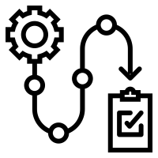
Comparative Analysis of Depreciation Methods
- Straight-Line Method
-Diminishing Balance Method
About Depreciation Schedule

Slide 3

Information about the terminologies:
Asset Cost: The initial cost of the asset.
Additional Asset Cost: Any additional costs incurred in acquiring the asset.
Asset Price: The total cost of the asset, including any additional costs.
Scrap Value: The estimated residual or salvage value of the asset at the end of its useful life.
Estimated Life Span (Years): The expected number of years over which the asset will be depreciated.
Depreciation/Year as per Straight Line Method: The amount of depreciation allocated to each year of the asset's useful life, calculated as (Asset Price - Scrap Value) / Estimated Life Span.
Depreciation Percentage: The annual depreciation rate, calculated as (Depreciation/Year as per Straight Line Method) / Asset Price.
Total Depreciation For Its Life Span: The total depreciation expense over the asset's entire useful life, calculated as (Depreciation/Year as per Straight Line Method) * Estimated Life Span.
Depreciated Book Value After Its Life Span: The value of the asset after it has been fully depreciated, equal to the scrap value.
Balance Amount: Any remaining balance after fully depreciating the asset, which should ideally be zero.
Diminishing Balance Method:
Rate of Depreciation as per Diminishing Balance Method: The annual depreciation rate calculated based on the diminishing balance method.
Depreciation Schedule: A table showing the year-by-year depreciation amounts and the corresponding book values of the asset.

Slide 4
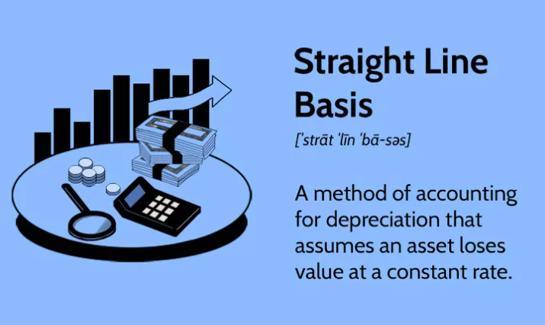
Straight Line Method : The Straight Line method calculates a fixed amount that gets depreciated every year

Slide 5
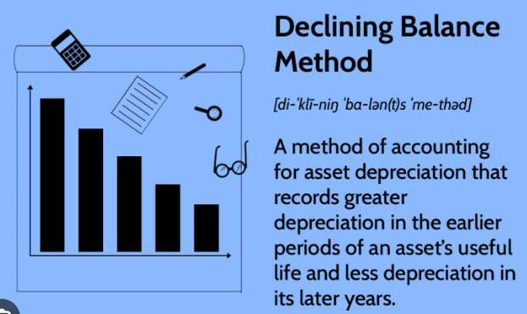
Diminishing Balance Method : According to the Diminishing Balance Method, depreciation is charged at a fixed percentage on the book value of the asset.

Slide 6
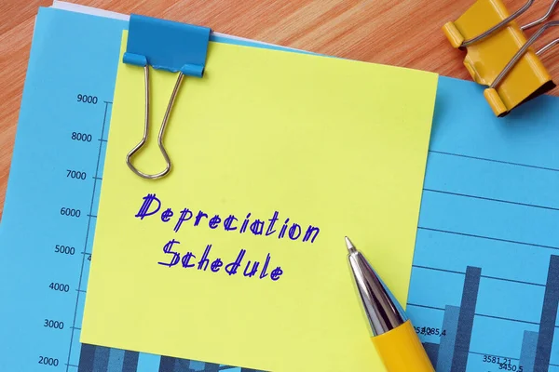
About Depreciation Schedule for 10 years: The charts the loss in value of an asset over the period you've designated as its useful life, using the accounting method you've chosen.

Slide 7


